Slide 1
Conference Management System
Team 3
Xiaohan Shen
Huiliang Ling
Shuang Zhang
Keqin Li

Slide 2
Roadmap
Introduction
Motivation
Related work
System design
System implementation
Demo
Experiments/analysis
Conclusions and future work

Slide 3
Introduction
Conference Management System
Login/Signup
Profile management
Paper Submission
Review Management
Conference Management
Admin page

Slide 4
Motivation
Deploy a easy-to-use conference management system
Use SOA/SOC to develop a software system supporting technical conference management
The software system serves for online paper submission, review, and registration.

Slide 5





Manage lifecycle of a paper
login
Assign PC member
Admin
Submit a paper to a conference
User
review
Your paper was rejected...
PC member
Reject the paper

Slide 6
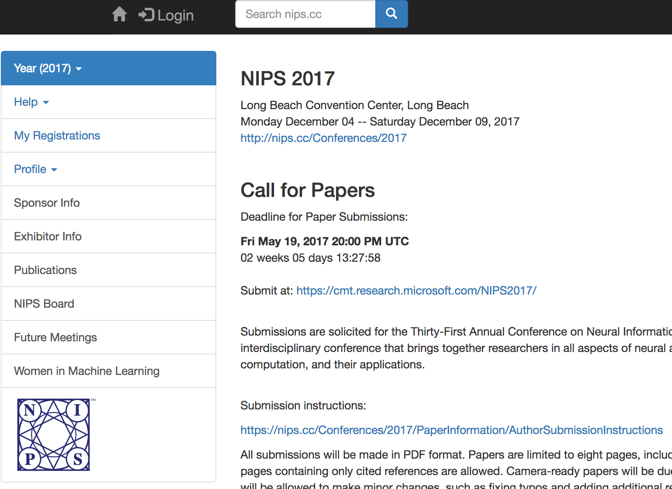
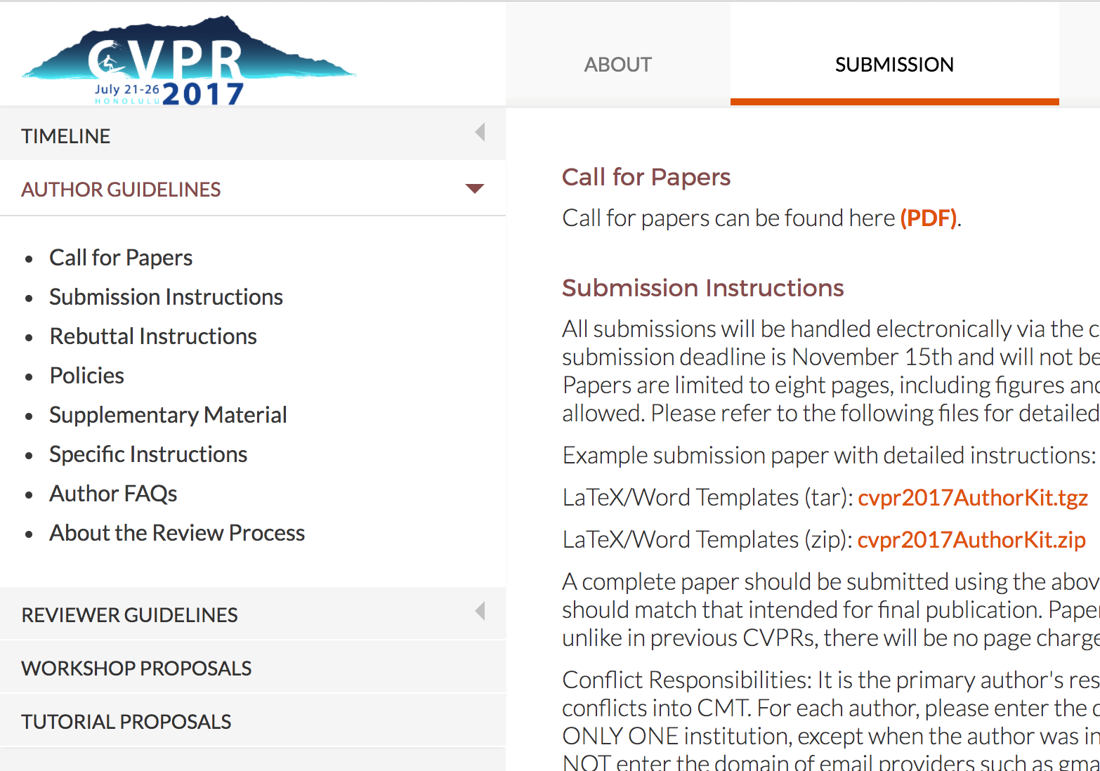
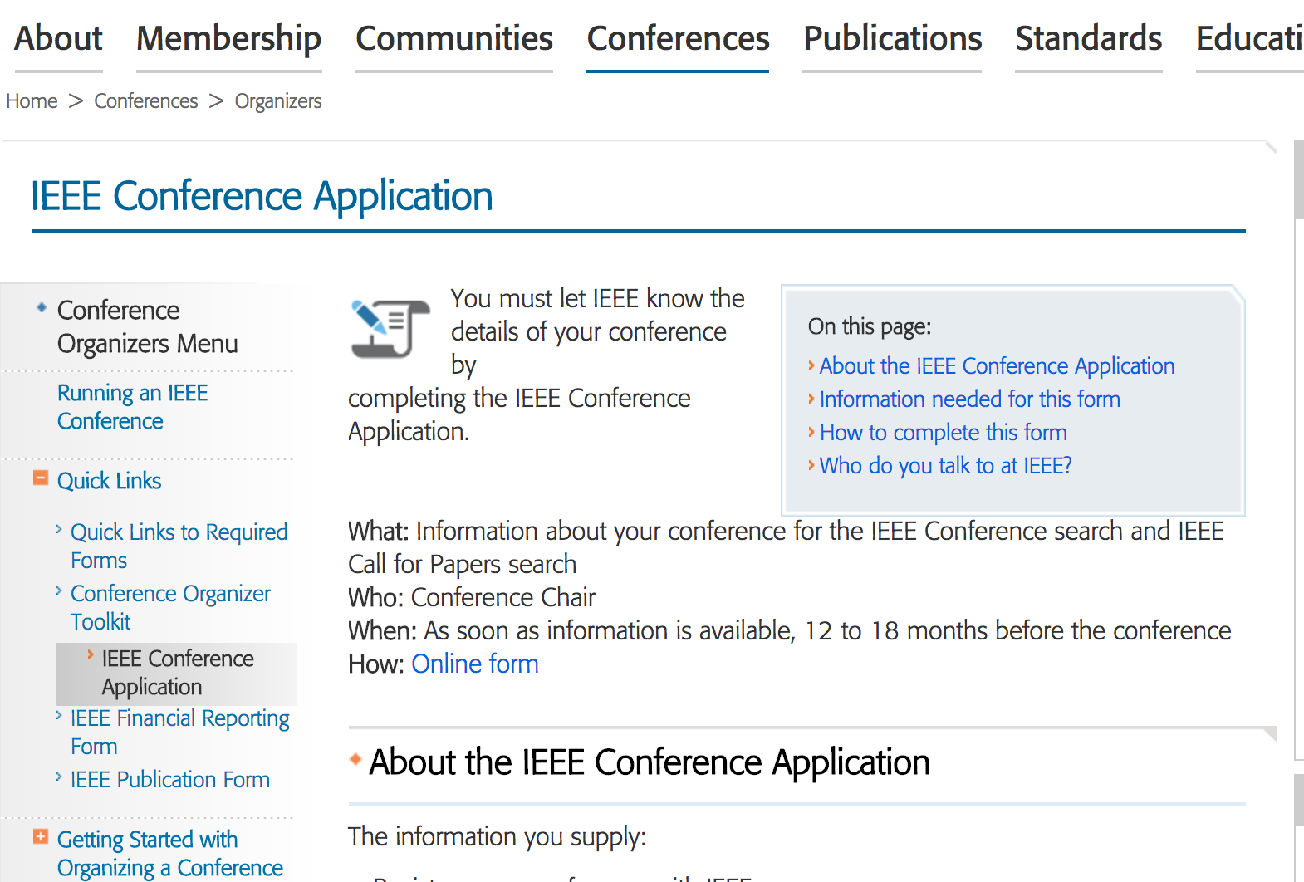
Related work
Many Conference ...

Slide 7
System design
view
Frontend
Controller
Restful API
Backend
Controller
model
DB
frontend
backend
Notes:
Apply MVC framework

Slide 8
Schema
Profile
Conference
User
id
ConferenceDetail
id
id
user_id
id
conference_id
username
...
conference_name
user_id
password
...
ifReview
email
ifChair
...
Review
Paper
id
id
Question
reviewer_id
user_id
id
paper_id
conference_id
Criteria
...
isCriteria=Y
isCriteria
paper_title
id
label
author
...
…
…

Slide 9





System Implementation
View
Frontend
Controller
Restful API
Backend
Controller
model
DB
frontend
backend
Code: https://github.com/cmusv-sc/18655-Spring-2017-Team-3
Notes:
Sbt manage dependencies

Slide 10
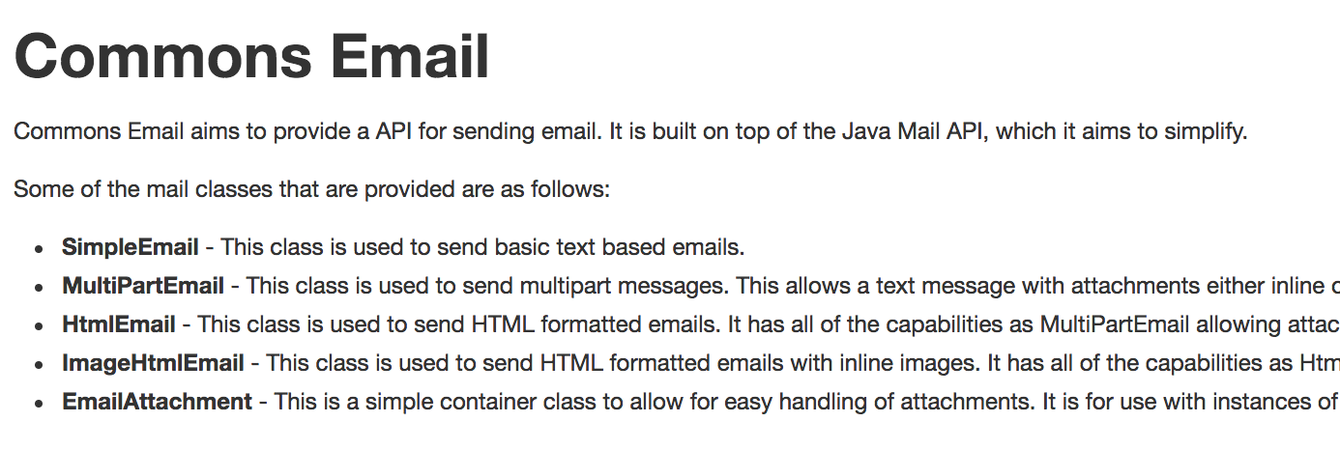
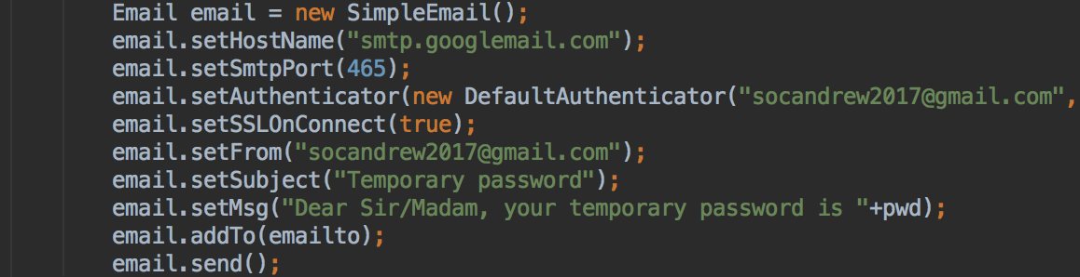
Notes:
API can be used to simplify our programming, we use apache commons email library to implement this functionality, where you can see we only use 10 lines.

Slide 11
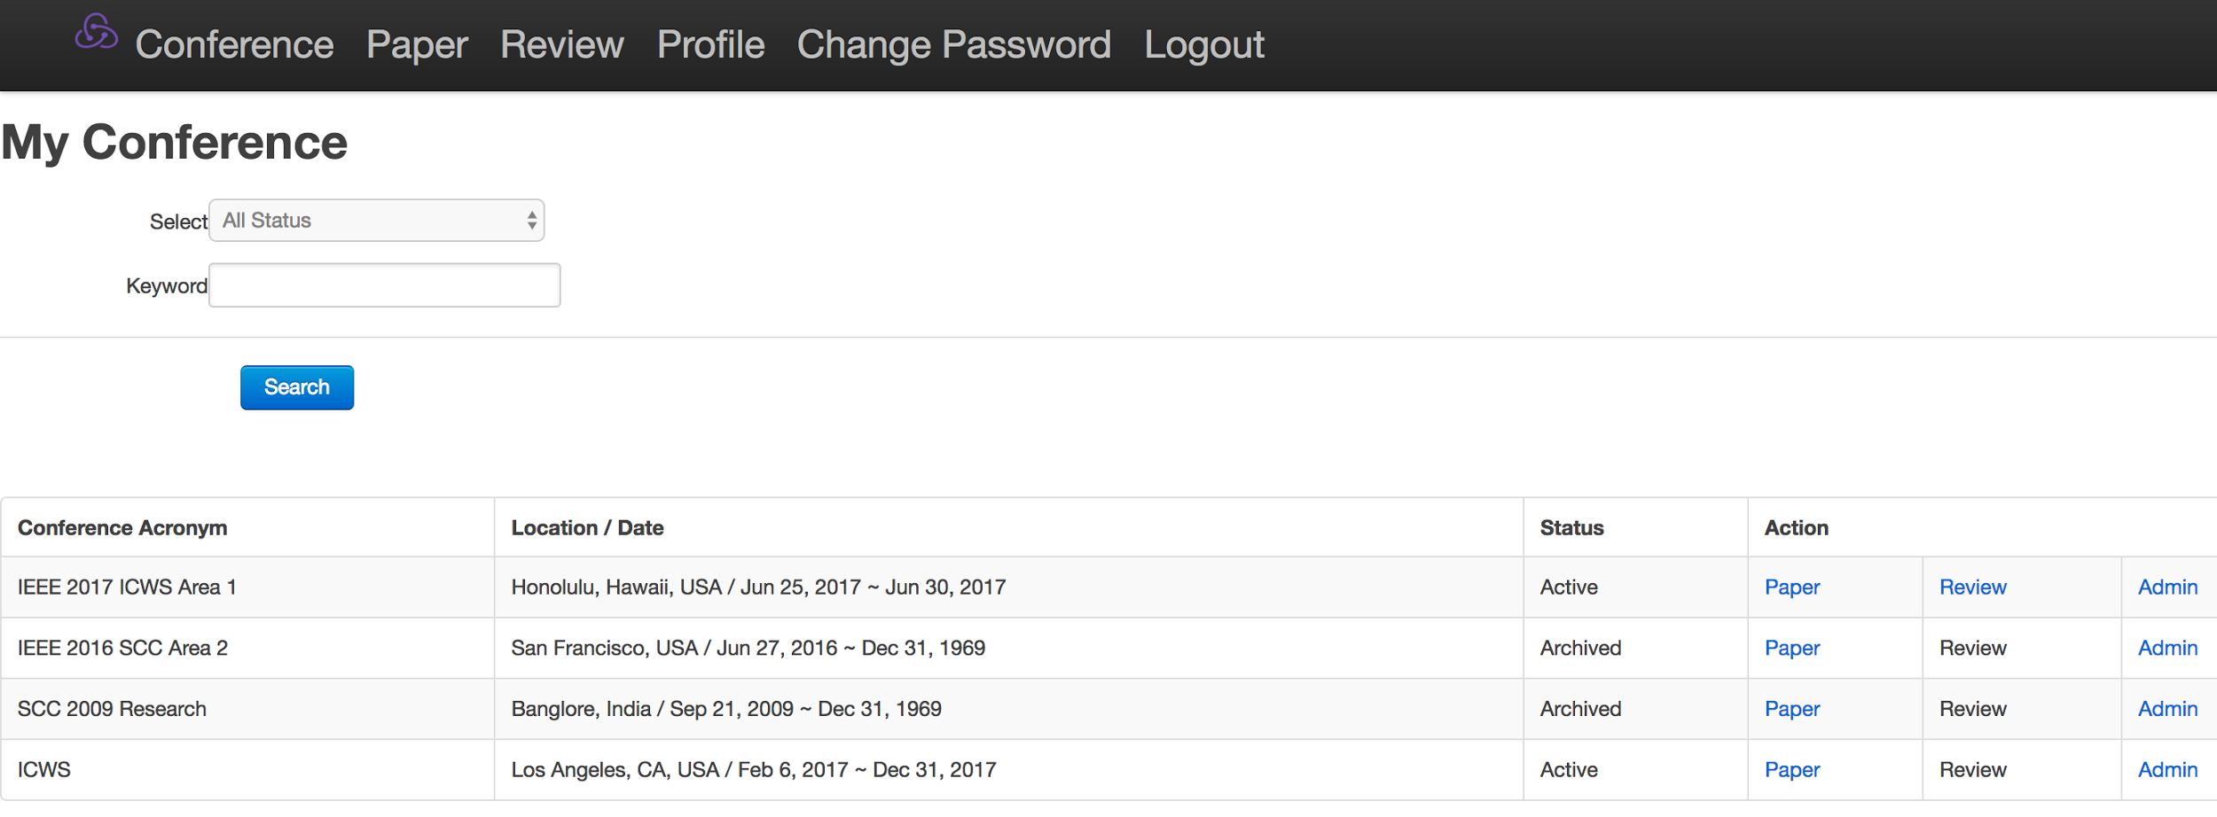
Conference Management System

Slide 12
Front End API Services
Description | URL | Request
Get Login Page | /login | GET
Verify User Info | /login | POST
Get User Profile | /profile | GET
Get Create Paper Page | /papers/new | GET
Save Paper Info | /papers | POST
Edit A Paper Info | /papers/:id | GET
Update Paper Info | /papers/:id | POST
Enter Review Page | /review | GET
... | ... | ...
Notes:
81 restful api

Slide 13
Back End API Services
Description | URL | RESTful Request
Verify User Info | /login | POST
Get User Profile | /profile/:id | GET
Edit User Profile | /profile/edit | POST
Delete User Profile | /profile/delete | POST
Save Paper Info | /papers | POST
Edit A Paper Info | /papers/:id | GET
Update Paper Info | /papers/:id | POST
Get Conference Info | /review/conf/:id | GET
... | ... | ...
Notes:
60 restful api

Slide 14
Demo
https://youtu.be/TXLrA5BA0IY

Slide 15
How to run
Code: https://github.com/cmusv-sc/18655-Spring-2017-Team-3
Start your mysql server
Backend: activator run
Frontend: activator “run 8080”

Slide 16

Experiment and Analysis: Spec-based test

Slide 17
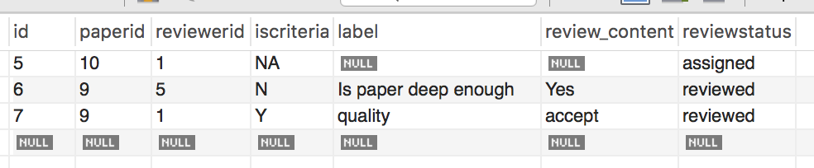
Experiment and Analysis: Usability test
Add review criteria/questions -> show all of them in “update review”
PC chair assigns paper to reviewers -> show this paper for reviewers

Slide 18
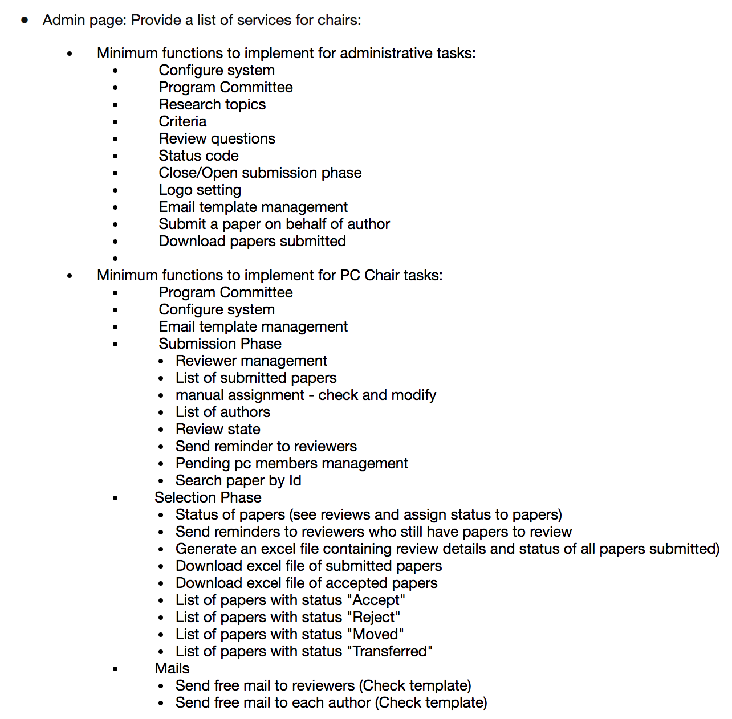

Experiment and Analysis: Agile development

Slide 19
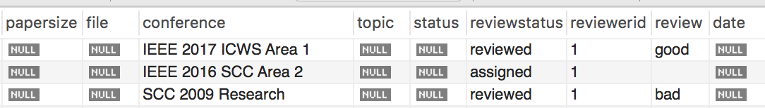

Experiment and Analysis: Agile development

Slide 20
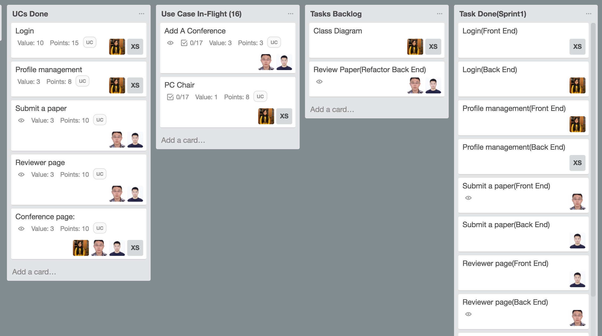
Experiment and Analysis: Trello

Slide 21
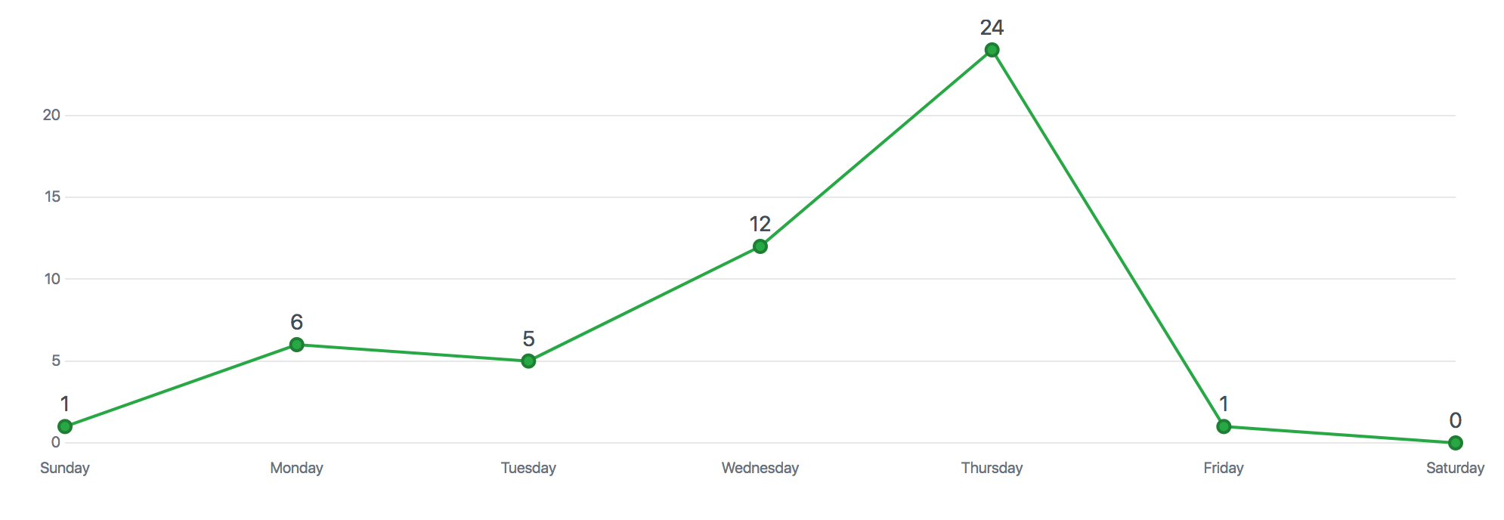
Experiment and Analysis: Github commits

Slide 22
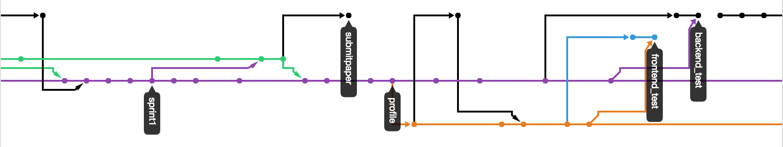
Experiment and Analysis: Github branch tree

Slide 23

Conclusion Future
Completed! More features
But what else? More flexibility
Concise in one page

Slide 24


